Slide 1
Programming with OmpSs
Seminaris d’Empresa 2013
Vicenç Beltran,
vbeltran@bsc.es
Barcelona, 2013

Slide 2
Outline
Motivation
  Parallel programming
  Heterogeneous Programming
OMPSs
  Philosophy
  Tool-chain
  Execution model
  Integration with CUDA/OpenCL
  Performance
Conclusions

Slide 3
Motivation
Parallel programming
  Pthreads
    Hard and error prone (dead-locks, race-conditions, …)
  OpenMP
    Limited to parallel loops on SMP machines
  MPI
    Message passing for clusters
  New parallel programming models
    MapReduce, Intel TBB, PGAS, …
    More powerful and safe, but …
    Effort to port legacy applications too high

Slide 4
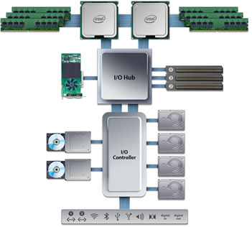
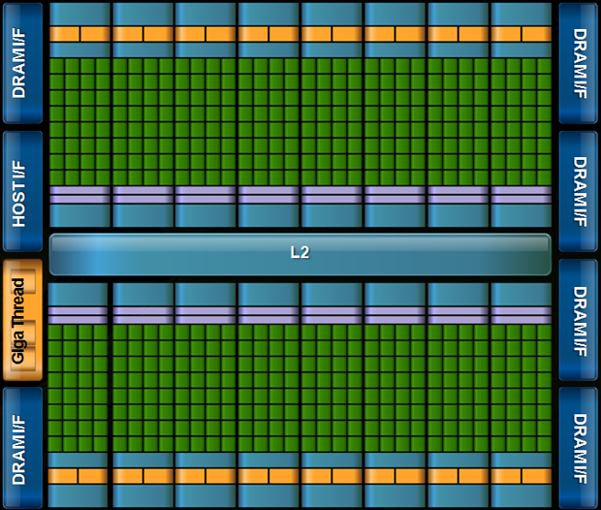
Motivation
Heterogeneous Programming
  Two main alternatives CUDA/OpenCL (very similar)
    Accelerator language (CUDA C/OpenCL C)
    Host API
      Data transfers (two address spaces)
      Kernel management (compilation, execution , …)
cudaMemcpy(devh,h,sizeof(*h)*nr*DIM2_H, cudaMemcpyHostToDevice);
Host memory
Device memory

Slide 5
Motivation
Heterogeneous Programming
  Two main alternatives CUDA/OpenCL (very similar)
    Accelerator language (CUDA C/OpenCL C)
    Host API
      Data transfers (two address spaces)
      Kernel management (compilation, execution , …)
// Initialize device, context, and buffers
...
memobjs[1] = clCreateBuffer(context, CL_MEM_READ_ONLY | CL_MEM_COPY_HOST_PTR,
sizeof(cl_float4) * n, srcB, NULL);
// create the kernel
kernel = clCreateKernel (program, “dot_product”, NULL);
// set the args values
err = clSetKernelArg (kernel, 0, sizeof(cl_mem), (void *) &memobjs[0]);
err |= clSetKernelArg (kernel, 1, sizeof(cl_mem), (void *) &memobjs[1]);
err |= clSetKernelArg (kernel, 2, sizeof(cl_mem), (void *) &memobjs[2]);
// set work-item dimensions
global_work_size[0] = n;
local_work_size[0] = 1;
// execute the kernel
err = clEnqueueNDRangeKernel (cmd_queue, kernel, 1, NULL, global_work_size,
local_work_size, 0, NULL, NULL);
// read results
err = clEnqueueReadBuffer (cmd_queue, memobjs[2], CL_TRUE, 0,
n*sizeof(cl_float), dst, 0, NULL, NULL);
...
__kernel void
dot_product (
__global const float4 * a,
__global const float4 * b,
__global float4 * c)
{
int gid = get_global_id(0);
c[gid] = dot(a[gid], b[gid]);
}
Main.c
kernel.cl

Slide 6
Outline
Motivation
  Parallel programming
  Heterogeneous Programming
OMPSs
  Philosophy
  Tool-chain
  Execution model
  Integration with CUDA/OpenCL
  Performance
Conclusions

Slide 7
OmpSs
Philosophy
  Based/compatible with OpenMP
    Write sequential programs an run them in parallel
    Support most of the OpenMP annotations
  Extend OpenMP with function-tasks and parameter annotations
    Provide dynamic parallelism and automatic dependency management
#pragma omp task input ([size] c) output ([size] b)
void scale_task (double *b, double *c, double scalar, int size)
{
int j;
for (j=0; j < size; j++)
b[j] = scalar*c[j];
}

Slide 8
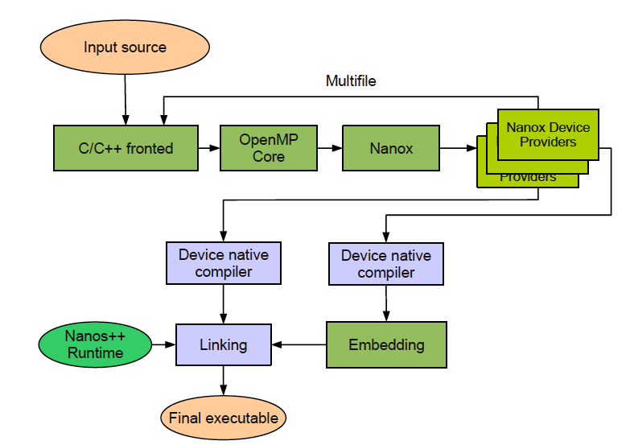
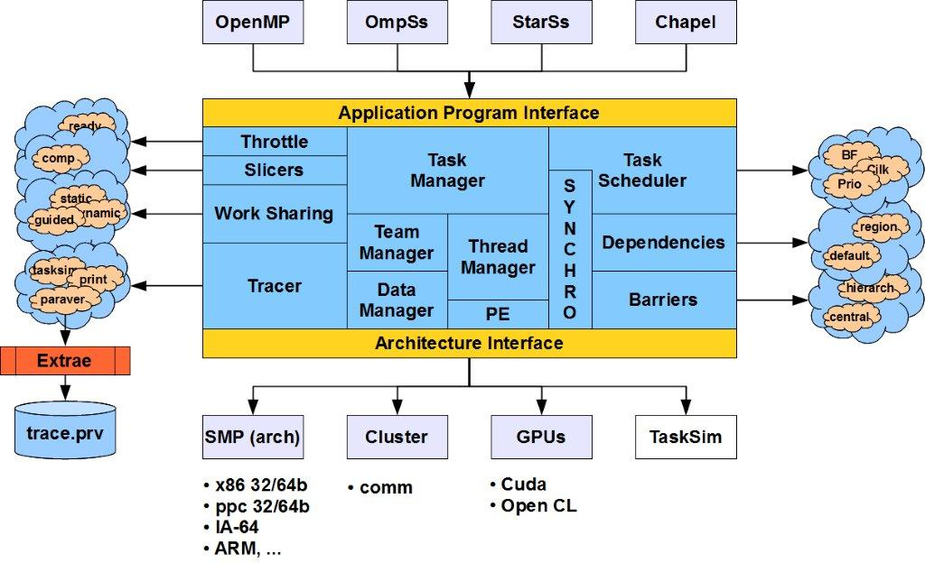
OmpSs
Tool-chain
  Mercurium
    Source-to-source compiler
    Supports Fortran, C and C++
  Nanos++
    Common execution runtime (C, C++ and Fortran)
    Task creation, dependency management, task scheduling, …

Slide 9
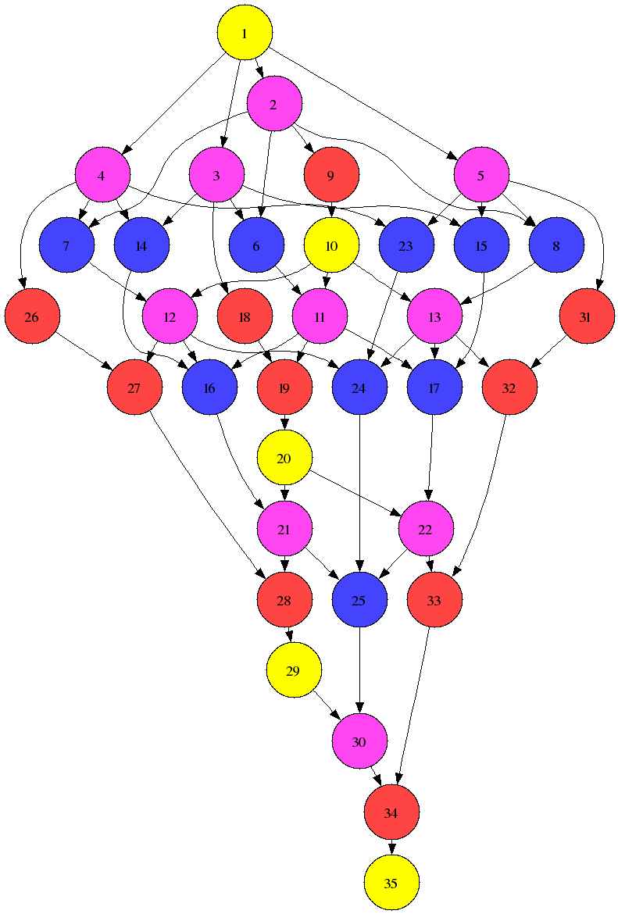
OmpSs
Execution model
  Dataflow execution model (deps. based on in/out annotations)
  Dynamic task-scheduling on available resource
TS
void Cholesky(int NT, float *A[NT][NT] ) {
for (int k=0; k<NT; k++) {
spotrf (A[k][k], TS) ;
for (int i=k+1; i<NT; i++)
strsm (A[k][k], A[k][i], TS);
for (int i=k+1; i<NT; i++) {
for (j=k+1; j<i; j++)
sgemm( A[k][i], A[k][j], A[j][i], TS);
ssyrk (A[k][i], A[i][i], TS);
}
}
}
NB
TS
NB
TS
TS
#pragma omp task inout ([TS][TS]A)
void spotrf (float *A, int TS);
#pragma omp task input ([TS][TS]T) inout ([TS][TS]B)
void strsm (float *T, float *B, int TS);
#pragma omp task input ([TS][TS]A,[TS][TS]B) inout ([TS][TS]C )
void sgemm (float *A, float *B, float *C, int TS);
#pragma omp task input ([TS][TS]A) inout ([TS][TS]C)
void ssyrk (float *A, float *C, int TS);

Slide 10
OmpSs
Integration with CUDA/OpenCL
  #pragma omp target device(CUDA|OCL)
    Identifies the following function as CUDA C/OpenCL C kernel
  #pragma omp input(…) output(…) ndrange(dim, size, block_size)
    Specifies input/output as usual and provides the information to call the kernel.
  No need to modify CUDA C code
__global_ void scale_task_cuda (double *b, double *c, double scalar, int size)
{
int j = blockDim.x * blockIdx.x + threadIdx.x;
if(j<size) {
b[j] = scalar*c[j];
}
}
kernel.cu

Slide 11
OmpSs
Integration with CUDA/OpenCL
#pragma target device (smp) copy_deps
#pragma omp task input ([size] c) output ([size] b)
void scale_task (double *b, double *c, double scalar, int size)
{
for (int j=0; j < size; j++) b[j] = scalar*c[j];
}
#pragma target device (cuda) copy_deps ndrange(1, size, 128)
#pragma omp task input ([size] c) output ([size] b)
__global_ void scale_task_cuda (double *b, double *c, double scalar, int size);
main.c
double A[1024], B[1024], C[1024]
double D[1024], E[1024];
main(){
…
scale_task_cuda(A, B, 10.0, 1024); //T1
scale_task_cuda(B, A, 0.01, 1024); //T2
scale_task (C, A, 2.0, 1024); //T3
scale_task_cuda (D, E, 5.0, 1024); //T4
scale_task_cuda(B, C, 3.0, 1024); //T5
#pragma omp taskwait
// can access any of A,B,C,D,E
}
A, B have to be transferred to device before task execution
main.c
No data transfer. Will execute after T1
A, has to be transferred to host.
Can be done in parallel with T2
D, E, have to be transferred to GPU.
Can be done at the very beginning
C has to be transferred to GPU.
Can be done when T3 finishes
Copy D, E back to host

Slide 12
OmpSs
Performance
  Dataflow-execution (asynchronous)
  Overlapping of data transfers and computation
    CUDA streams / OpenCL async copies
  Data prefetching from/to CPUs/GPUs
    Low level-optimizations
Data transfers
(H to D stream)
Copy outputs task (i-1)
Kernel call task (i)
Copy inputs task (i+1)
Kernel exec
Stream sync
(H <--> D streams)
Data transfers
(D to H stream)
Nanos++ mgt thread
(host side)
GPU side

Slide 13
Conclusions
OmpSs is a programming model that enables
  Incremental parallelization of sequential code
  Data-flow execution model (asynchronous)
  Nicely supports heterogeneous environments
  Many optimizations under the hood
    Advanced scheduling policies
    Work stealing/load balancing
    Data prefetching
  Advanced features
    MPI task offload
    Dynamic load balancing
    implements
OmpSs is open source
  Take a look at http://pm.bsc.es/ompss

Slide 14
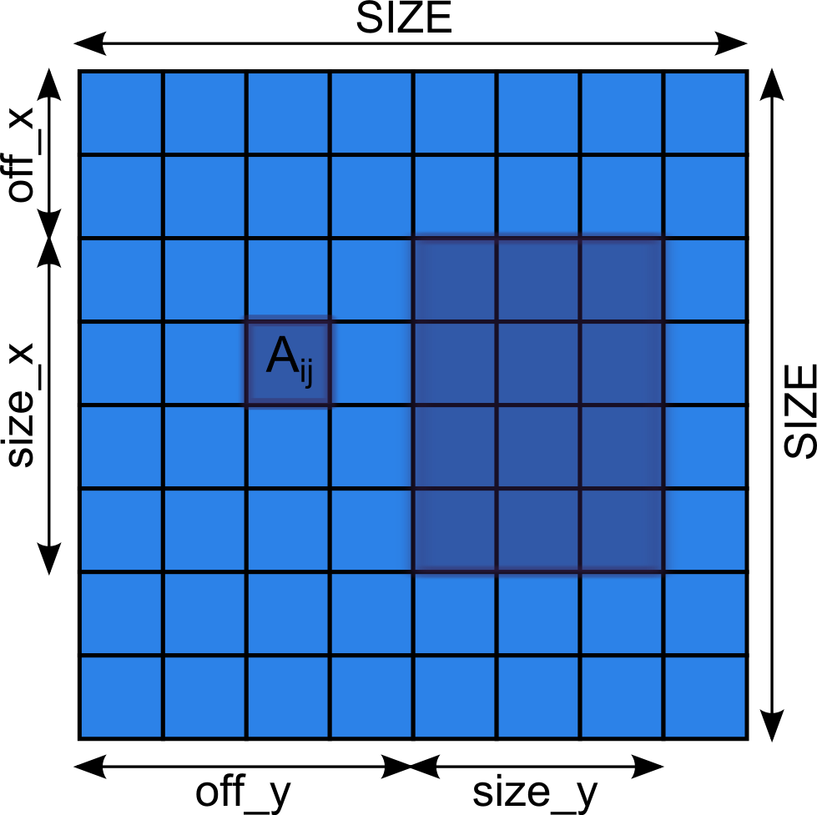
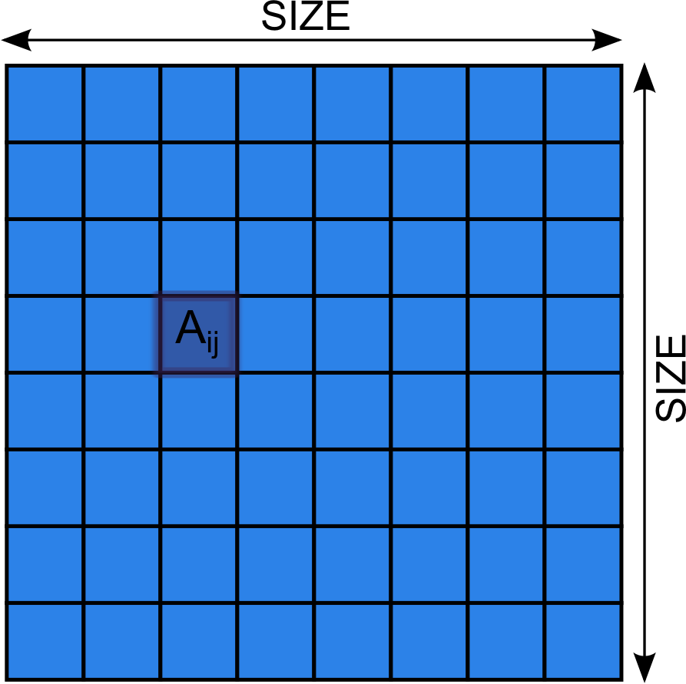
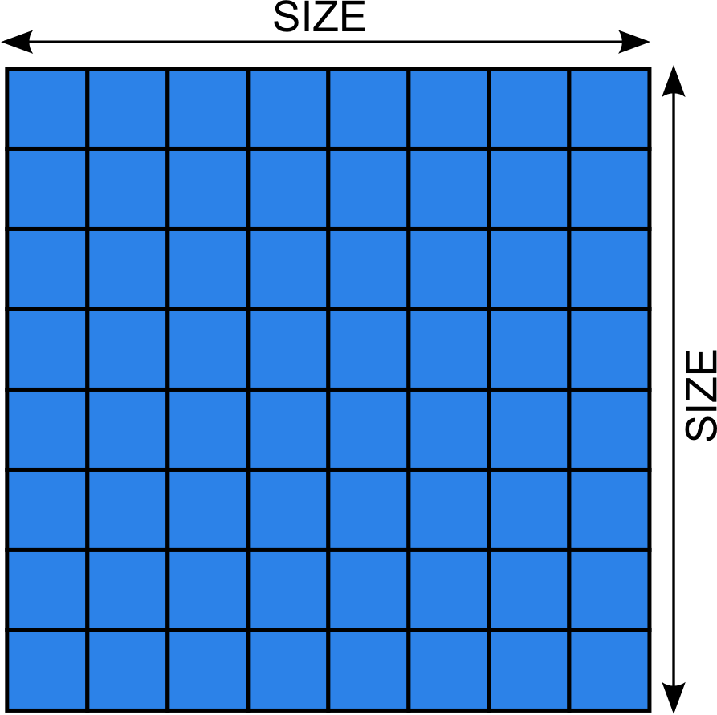

Appendix
    Input/output specification
      Whole (multidimensional) arrays
      Array ranges
int off_x = …, size_x = …, off_y = …, size_y = …;
#pragma omp target device(gpu) copy_deps
#pragma omp task input(A) \
output(A[i][j]) \
output([2][3]A) \
output(A[off_x;size_x][off_y;size_y)
void foo_task(float A[SIZE][SIZE], int i, int j);

Slide 15
Appendix II
    Pragma “implements”
__global_ void scale_task_cuda (double *b, double *c, double scalar, int size)
{
int j = blockDim.x * blockIdx.x + threadIdx.x;
if(j<size) {
b[j] = scalar*c[j];
}
}
kernel.cu
double A[1024], B[1024], C[1024] D[1024], E[1024];
main(){
…
scale_task(A, B, 10.0, 1024); //T1
scale_task(B, A, 0.01, 1024); //T2
scale_task(C, A, 2.0, 1024); //T3
scale_task(D, E, 5.0, 1024); //T4
scale_task(B, C, 3.0, 1024); //T5
#pragma omp taskwait
// can access any of A,B,C,D,E
}
#pragma target device (smp) copy_deps
#pragma omp task input ([size] c) output ([size] b)
void scale_task (double *b, double *c, double scalar, int size)
{
for (int j=0; j < size; j++) b[j] = scalar*c[j];
}
#pragma target device (cuda) copy_deps ndrange(1, size, 128)
#pragma omp task input ([size] c) output ([size] b) implements(scale_task)
__global_ void scale_task_cuda (double *b, double *c, double scalar, int size);
main.c

Slide 16
Appendix III
    Known issues
      Only functions that returns void can be tasks
      No dependencies on parameters passed by value
      Local variables may “escape” the scope of the executing task
#pragma omp taskwait out([size]tmp) out(*res)
void foo_task(int *tmp, int size, int *res);
int main(…)
{
int res = 0;
for(int i=0; …) {
int tmp[N];
foo_task(tmp, N, &res);
}
#pragma omp taskwait
}

Slide 17
Hands-on
Account information
  Host: bscgpu1.bsc.es
  Username/password: nct01XXX/PwD.AE2013.XXX (XXX-> 001..014)
  My home: /home/nct/nct00002/seminario2003
First command
  Read the README file on each directory
    hello_world
    cholesky
    nbody
Job queue system
  mnsubmit run.sh
  mnq
  mncancel

Slide 18
nct00002
nct.2013.002

